Slide 1
Patient Management System
Nathaniel Pyo & Jimmy Cheung
Notes:
Hello yes hello this is our (names) patient management system using prio q

Slide 2
Introduction
Problem Statement: Hospital patient management queues can be difficult to arrange when considering both severity and the time a patient has been waiting.
Project Scope
The aim is to construct an algorithm the receives patient information and organizes a priority queue structured around two principles: severity and wait time.
Objectives | Goals
Prioritize patient severity over arrival order
Prevent excessive delays and address time-sensitivity
Incorporate a timer to override past a max wait time threshold
Notes:
Oftentimes in urgent care or emergency rooms patients with less severe problems end up waiting for extensive amounts of time, can anyone give an example woohoo
So, when considering both severity and wait time, arranging hospital queues can be rather difficult, our project is aimed to construct an algorithm that intakes patient information and provides a solution around prioritizing based on severity and wait time.
The major objectives are to prioritize based on severity, but then override with wait time once a certain threshold is reached.

Slide 3


Literature Review
Priority Queue
Notes:
In investigating existing literature of priority queues for our implementation, we found that priority queues auto sort in increasing or decreasing order. Additionally, as we’ll see later, this auto sort functionality results in O(logn) complexity when adding or removing elements.

Slide 4
Methodology

Slide 5

Clerk Window
The window will be open for 5 seconds, check duration to verify
Add and serve patients while the window is open
Print current patient served and line status
Implement a slight delay between new patients added
Close window and serve remaining patients
Notes:
To simulate the operation of a hospital clerk window, the window is held open for 5 seconds, in which the duration from the start is updated at the end of every loop. While the window is open, patients are added and served, and the line status is displayed. A slight delay is incorporated to make the output more readable, and once the window is closed any remaining patients in line are served.

Slide 6
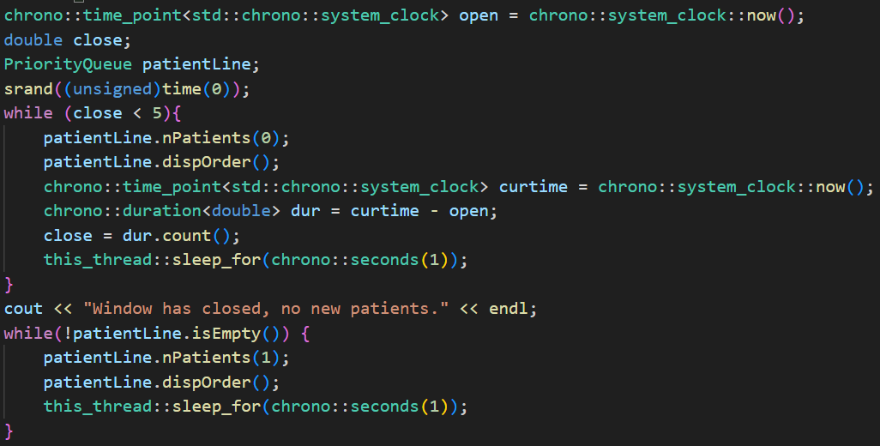
Notes:
Here is our implementation, with the time point initialized and random seed which will be used for assigning new patients, while the window is open patients are added, the line is displayed, and the duration since opening is updated. Once the window is closed patients are served but not added, the line is displayed, and we see both delays for output here and here.

Slide 7
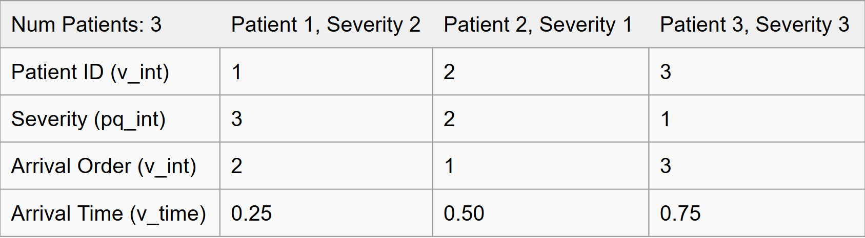
Add Patients
Generate random number 0-3 representing number of new patients
Generate random number 1-3 for each patient representing severity
Record patient ID, severity arrival order, and arrival time in vector
Record severity in priority queue
Notes:
Adding patients is done by generating a random number of patients from 0-3 and assigning each a random severity from 1-3. Each patient also has a unique id, and their arrival order and arrival time point is stored in vectors. The severity is stored in a priority queue. Here we have a sample where 3 patients are added with severities 2 1 and 3. The severities are added to the arrival order vector, the time is stored, and patient ID generated. The severity queue auto sorts the severities when added.

Slide 8
Serve Patients
Check if wait time threshold of 3 seconds has been reached
Call function to calculate duration after being sent arrival time
If max wait time not reached, serve highest severity patient
If max wait time reached, serve patient for which max time reached
Match and remove all data attributes (ID, severity, order, time)
Call auxiliary functions to match up data attribute indices
Notes:
For serving patients, the wait time threshold, defined as 3 seconds, is first checked by calculating duration from start point in the timer vector. If the threshold is not reached the highest severity patient is served, but if the threshold is reached then the patient that has been waiting the longest is served. Additionally, as we saw before, the severity queue auto sorts without preserving order, so auxiliary functions are used to sync and remove the correct data attributes once a patient is served

Slide 9
RECAP: welcome back everyone
Priority queue implementation to treat on severity basis unless wait time > 3
Wait time function checks if wait threshold (3 seconds) passed
Random number of patients generated (0-3) with random severity (1-3)
Window open for 5 seconds, no new patients after

Slide 10
Time Complexity
Window operations utilize a while loop: O(n)
Adding patients uses a combination of if statements and for loops
priority_queue.push() is O(logn) complexity
Push function contained within for loop: O(n*logn)
Serving patients uses a combination of if and for
priority_queue.pop() is O(logn) complexity
Pop function contained within for/while loop: O(n*logn)
For loops in aux functions for matching indices and checking wait time: O(n)
Total for queueing algorithm: O(n*logn)
Notes:
The window operations are O(n) complexity for the while loop, adding patients contains the push function for each patient added resulting in n*log(n) as push and pop are logn according to existing literature. Serving patients is similarly n*log(n), and the auxiliary matching and display functions are either n or n*log(n). As a result, the total for the queueing algorithm comes out to O(n*logn)

Slide 11
Analysis and Results

Slide 12
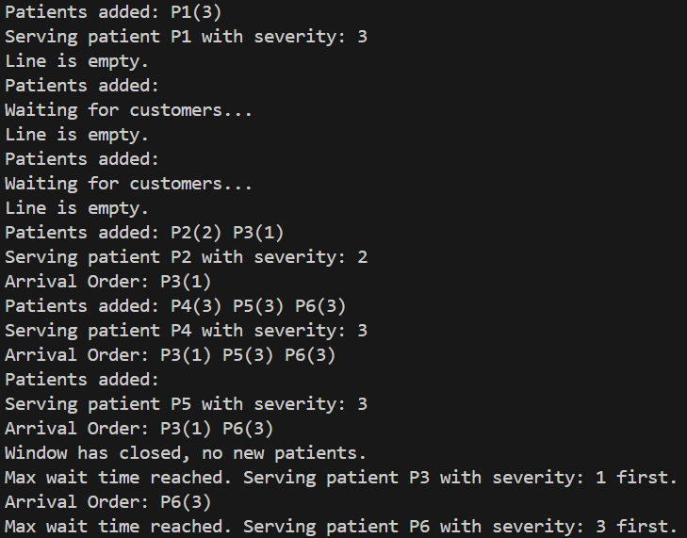
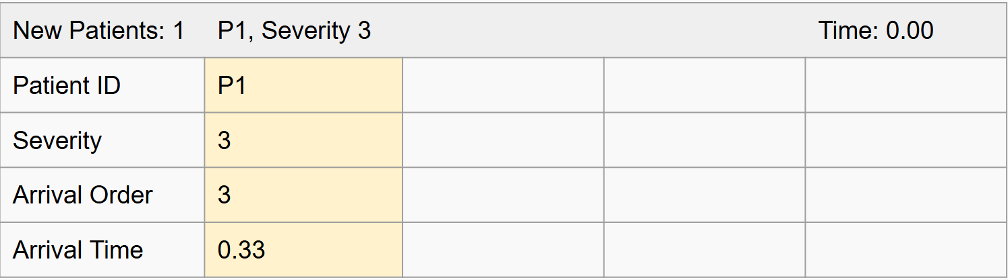
Notes:
Here we have an example output, which we’ll walkthrough for analysis. Patient 1 is added with severity 3, and all their information is recorded. The yellow highlight represents the patient being served

Slide 13
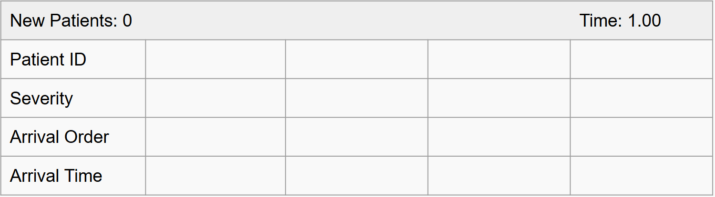
Notes:
Once p1 is served, the line is empty, no patients are added

Slide 14
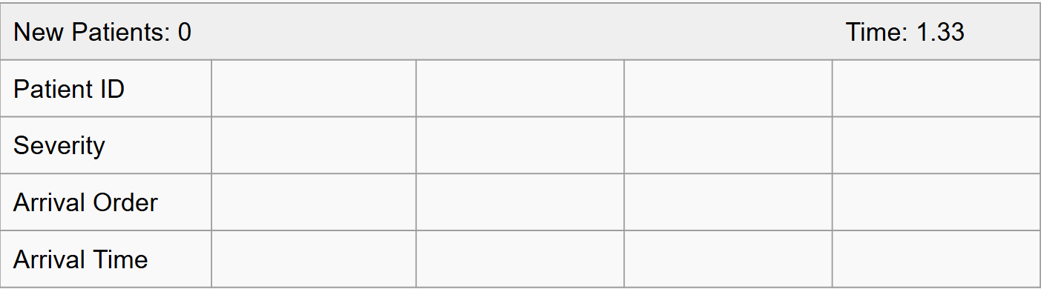
Notes:
For the next instance no patients are added once again, these cases were implemented to avoid segmentation faults and errors

Slide 15
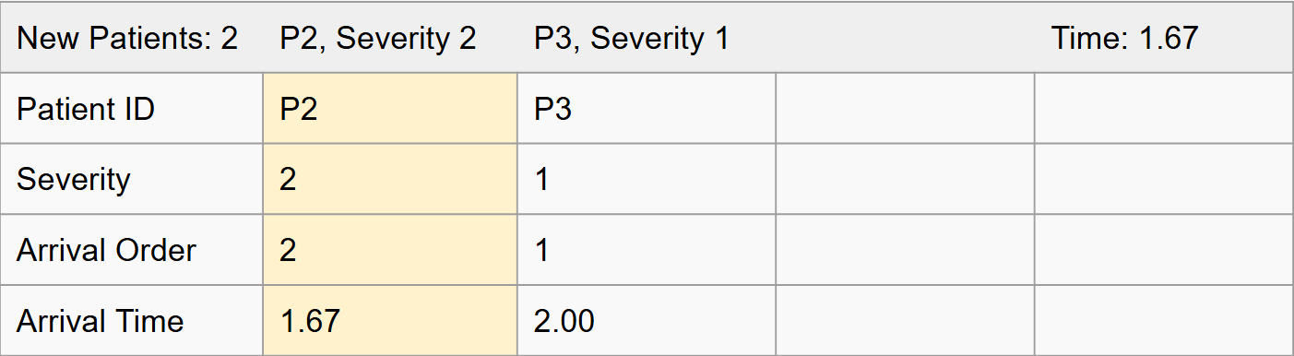
Notes:
2 new patients are added, p2 and p3 with severities 2 and 1, the data is recorded and p2 is served based on severity priority

Slide 16
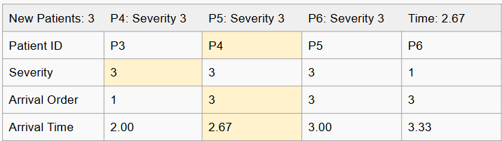
Notes:
3 new patients are added, and here we see the full effect of our algorithm. Notice that as p4 5 and 6 all have severity 3, p3’s severity gets pushed to the back of the severity queue. As the data attributes are not all at the same index, the first severity is served and the correct data attributes are matched and removed. Here we see patient 4 is served first.

Slide 17
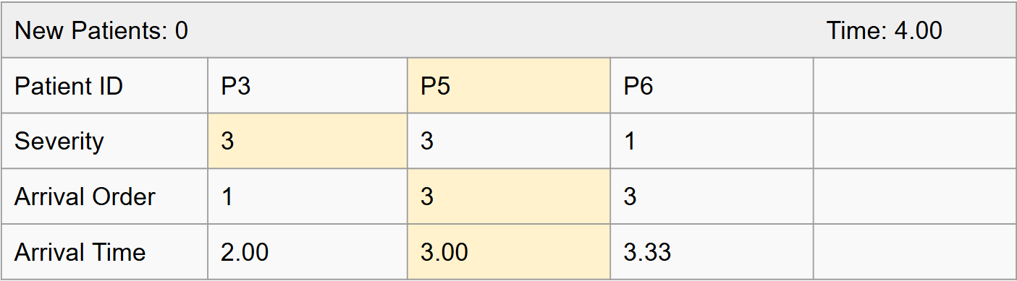
Notes:
The same occurs then for patient 5, no new patients are added

Slide 18
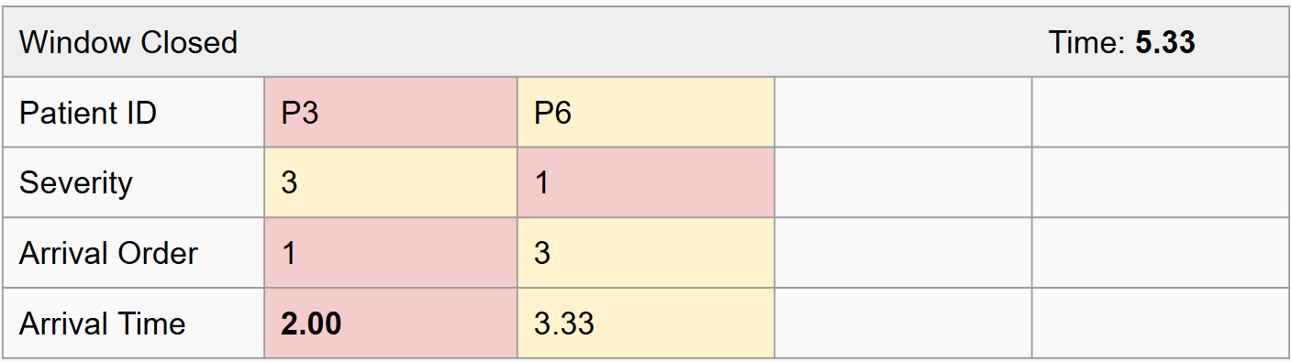
Notes:
Can anyone tell me which patient will be served first? Remember that the threshold we set was 3 seconds, and as the duration since arrival is greater than 3, patient 3 will be served first even though patient 6’s severity is precedent in the severity queue.

Slide 19
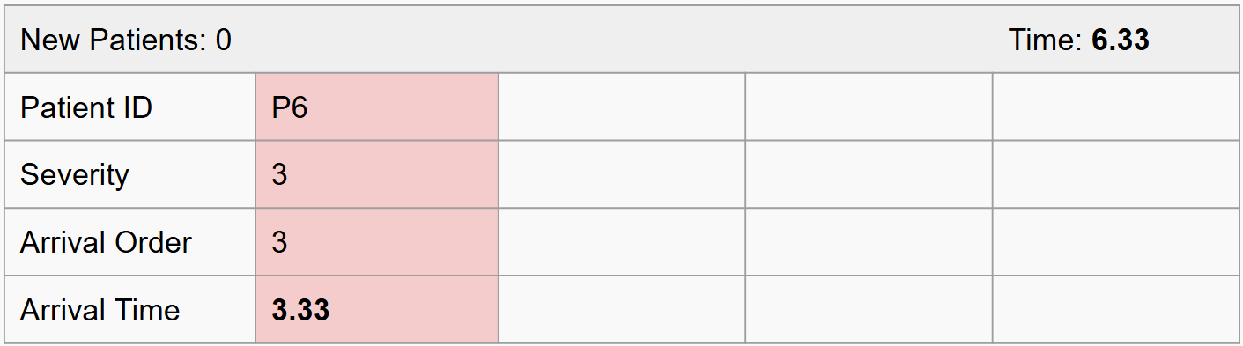
Notes:
Following, patient 6 is then served and the algorithm is finished.

Slide 20
Key Findings and Implications
Order Preservation: Input order is only preserved in priority queues for identical elements
Allows for the algorithm to sync data attributes by finding the first match
Wait Time Check: Logically, the patient that is first in the arrival order vector will have been waiting the longest, time complexity is reduced by only checking wait time for that patient
Hours Spent: 6 per week, 24 per month
Notes:
A key finding for priority queues was discovering the order is not preserved. Due to auto sorting, the order in which elements are added to the priority queue is only preserved if the elements are identical. This feature allows us to return an index match at the first match between the priority queue and other data structures. Additionally, the patient that arrived first will have waited for the longest, so the time complexity is reduced by only checking if the wait time has been passed for that patient. We spent around 6 hours a week or 24 hours a month on this project.

Slide 21
Project Limitations and Conclusions
Space Limitations: The algorithm solution is optimized for time complexity but utilizes 4 different data attributes across all functions. These data attributes are dynamically modified.
Priority Queues: The automatic sort functionality is considerably useful but does not preserve order. For algorithms where order preservation is unnecessary, priority queues are incredibly efficient and compact for their auto-sort capabilities.
Notes:
The most significant limitation was the usage of 4 different data structures to be accessed and dynamically modified throughout our algorithm. The solution is optimized for time efficiency, but the fact that order is not preserved in priority queues means we need some other method of order preservation. For algorithms where this is not necessary, priority queue are incredibly efficient and compact.

Slide 22
Project Limitations and Conclusions
Time Complexity: The time complexity of the algorithm was simplified due to the efficiency of priority queues. Some of the most efficient sorting algorithms are O(n*logn), and for the push and pop functions being O(logn), operating across all array elements is consistent at O(n*logn)
Notes:
In terms of time complexity, the most efficient sorting algorithms have a time complexity of n*logn, which our algorithm manages to stay within. This time complexity is also needed due to the nesting of push and pop functions across all array elements, resulting in n*logn.

Slide 23
Future Work
Connect with potential client
Implement the algorithm
Step 1
Step 3
Step 2
Step 4
Create a GUI
Expand
Notes:
Future work would imply connecting with potential clients, creating a GUI for output, implementing these algorithms, and expanding the algorithm according to specific client needs, like a different prioritization parameter.

Slide 24
References
GeeksforGeeks. (2024, October 11). Priority queue in C++ Standard Template Library (STL). GeeksforGeeks. https://www.geeksforgeeks.org/priority-queue-in-cpp-stl/
Notes:
In terms of time complexity, the most efficient sorting algorithms have a time complexity of n*logn, which our algorithm manages to stay within. This time complexity is also needed due to the nesting of push and pop functions across all array elements, resulting in n*logn.

